Slide 1

ML for Diabetes Prevention
Vittorio Haardt & Luca Porcelli

Slide 2
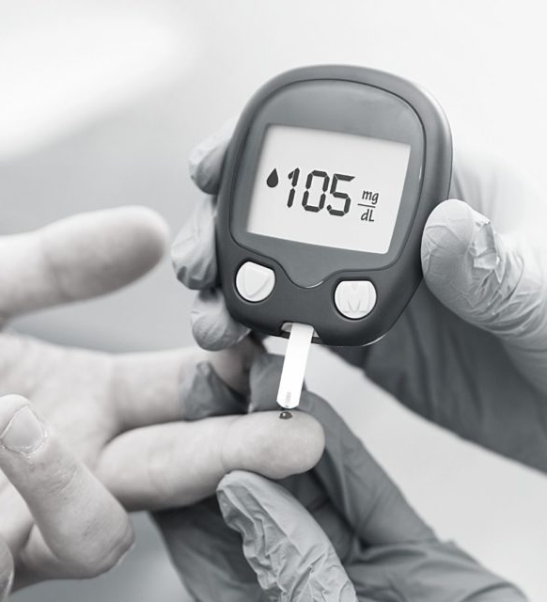
01
Project Goals
Effective diagnosis of diabetes can save lives

Slide 3
Make it Real
The goal was to produce a solution that could actually be useful for the diabetic diagnosis
A performing model | Achieved by an intensive and a careful ML procedure
An usable solution | Achieved by a deployment phased aimed to usability
A really useful tool | Achieved by an App build for generic users
The best technology is the one that everyone can use, without even thinking about it.
- Clayton Christensen

Slide 4
Sub-Goals
Training
Deployment
DataApp
Deployment of the right ML strategy in order to reach the optimal solution
Deployment of the best model in order to make it useful and usable
Deployment of the application in order to make the solution real

Slide 5

02
Data
Data as the foundation of ML solutions

Slide 6
The Right Data for the Right Model
Data:
51/49
12/17
40,108 observation from a bigger dataset
Diabetes: yes/no
Balanced class ideal for machine learining
y
5/17
5 integer variables
x_{i}
Input variables about life habits
12 string variables

Slide 7
Pre-Processing
Missing
Correlation
Variable Transformation
There was no missing values
There wasn’t redundant features
BMI from continuous in to categorical
1
2
3
4
5
Near-Zero Var
Outlier Removal
There wasn’t any near zero variance
Outlier removal based on BMI

Slide 8
BMI Pre-Processing
Outliers Removal
Variable Transformation
We removed them, as suggested by domain experts
BMI < 15
BMI > 50
Only from the training set, in order not to distort performance
On suggestions from domain experts.
BMI ⩽ 16 → INANITION
16 < BMI ⩽ 17.50 → UNDERWEIGHT
17.5 < BMI ⩽ 18.5 → SLIGHTLY UNDERWEIGHT
18.5 < BMI ⩽ 25 → NORMAL
25 < BMI ⩽ 30 → OVERWEIGHT
30 < BMI ⩽ 35 → CLASS I OBESE
35 < BMI ⩽ 40 → CLASS II OBESE
BMI > 40 → CLASS III OBESE

Slide 9
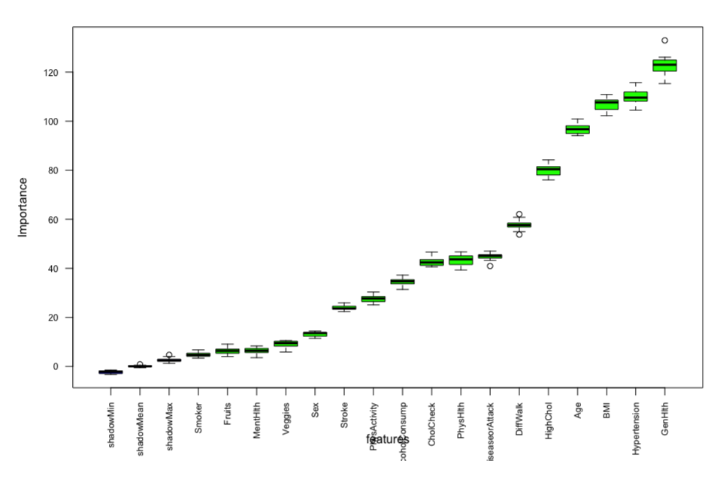
Feature Selection
Assessed with Boruta
All Attribute are Important
Since no attribute was placed under shadow attributes, we used it all for the models

Slide 10

03
ML Approach
Best performance to perform the best

Slide 11

ML Pipeline
10 fold CV
Cross Entropy
H_{p}(q)
Best Model
Model Evaluation
Data
Train 70%
Test 30%
Parameter Optimization
(grid/random search)

Slide 12
Provvisorio Screen – workflow cross validation hyperparameter optimization

Slide 13
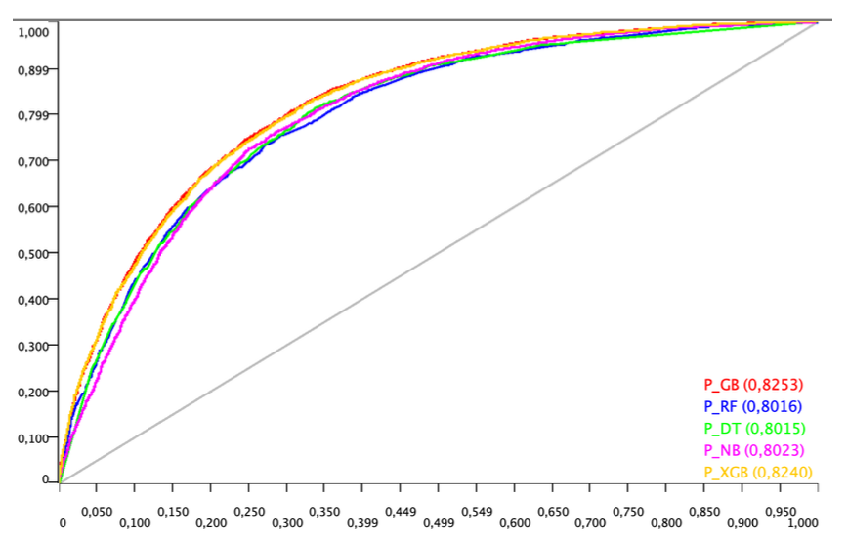
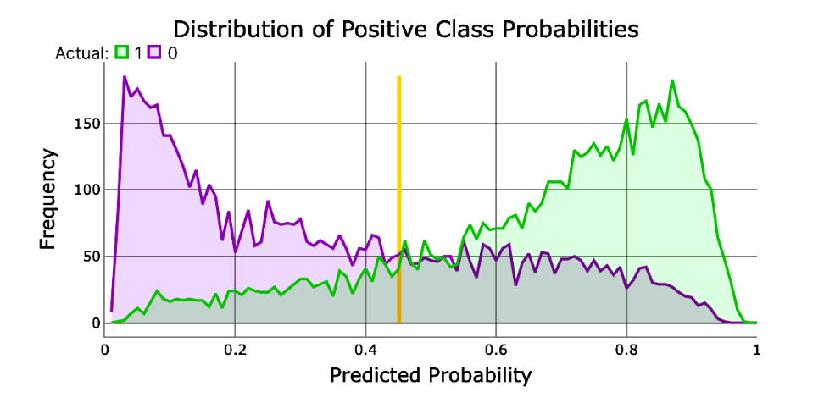
Models and Performances
Models
Evaluation
Best Model
Random Forest
Naïve Bayes
Gradient Boosting
Decision Tree
Gradient Boosting
Threshold
LogLoss
XGBoost
Staked Model
Accuracy
0.451

Slide 14
Provvisorio Staked model

Slide 15
Workflow
Actual use of the developed solution

Slide 16
A Tour on Knime
Training
Deployment
Workflow used to show the training phase, and explain the techniques involved in the process
Workflow built to an actual use of the solution developed in the training phase

Slide 17
Provvisorio Training

Slide 18
Provvisorio Deployment

Slide 19
Future Development
Better Model Selection
Different Optimization
Specific model selection for models can increase performance
Random is not the best option to find the best performance
Explainability
AI where humans can understand or predictions made by the AI.

Slide 20
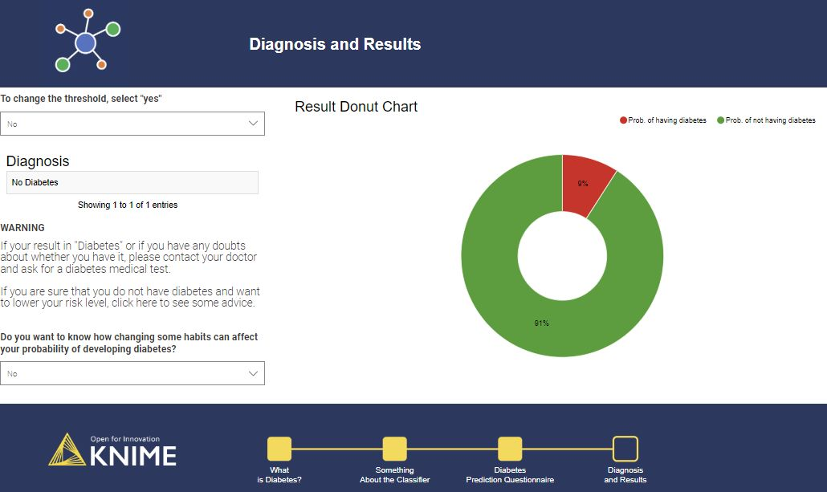
DataApp
An effective and simple application for diagnosing diabetes, which could potentially save lives
To the DataApp

Slide 21

The End
Thanks for the Attention

Slide 24
Piano B
Piano B

